Slide 1



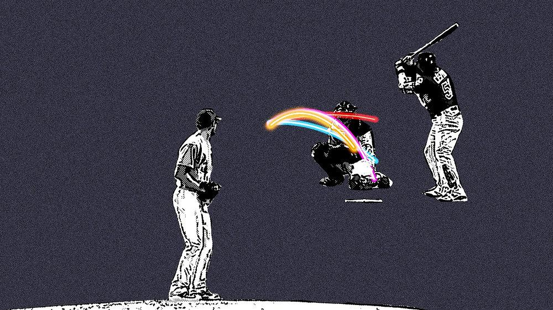
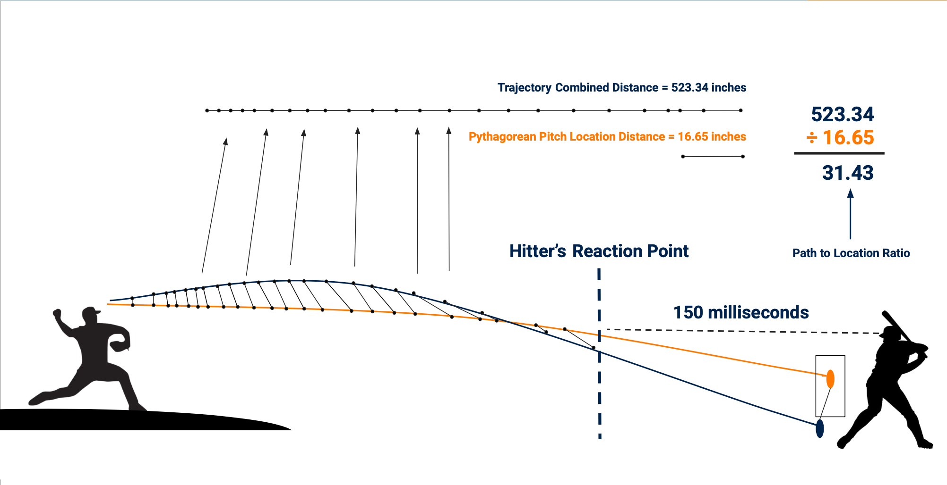
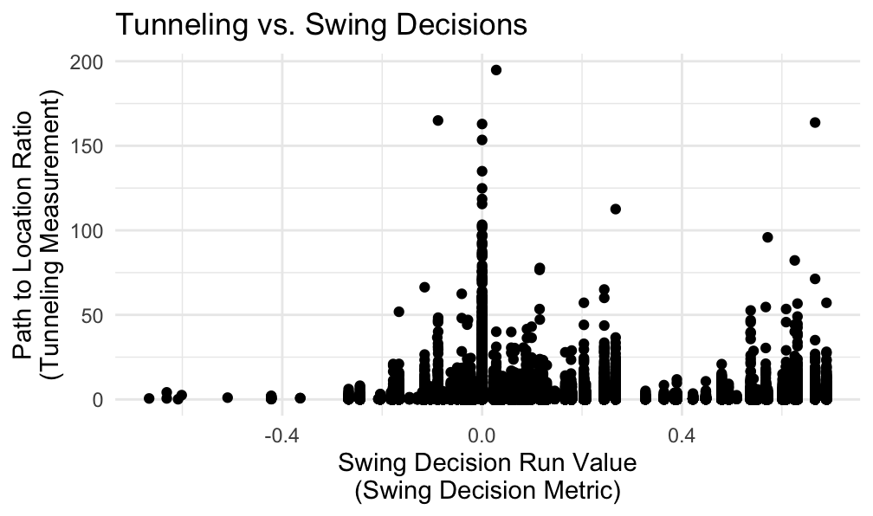
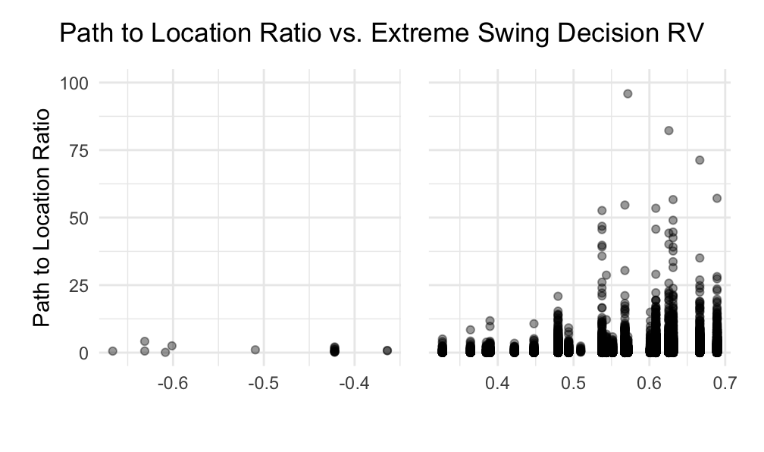
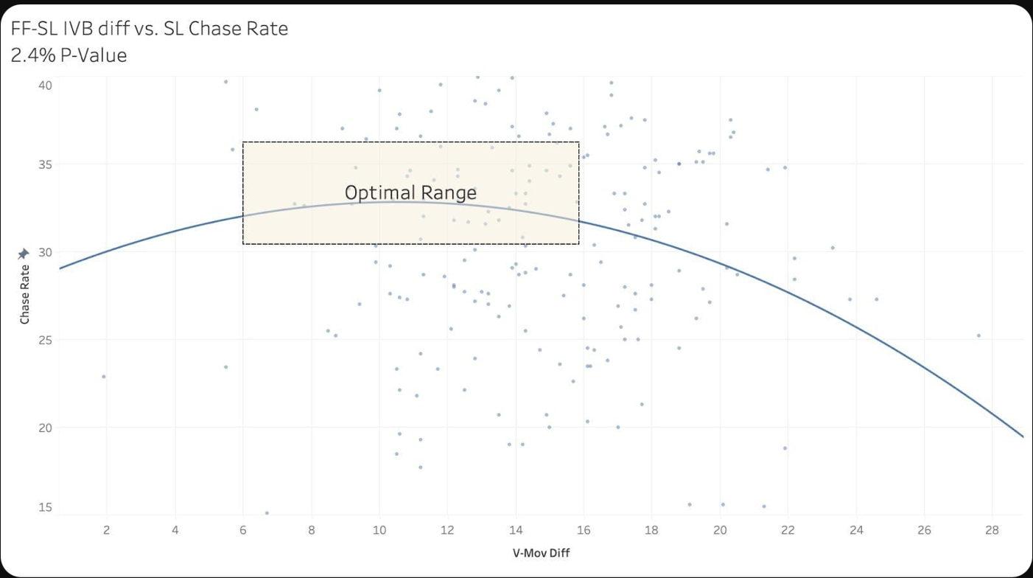
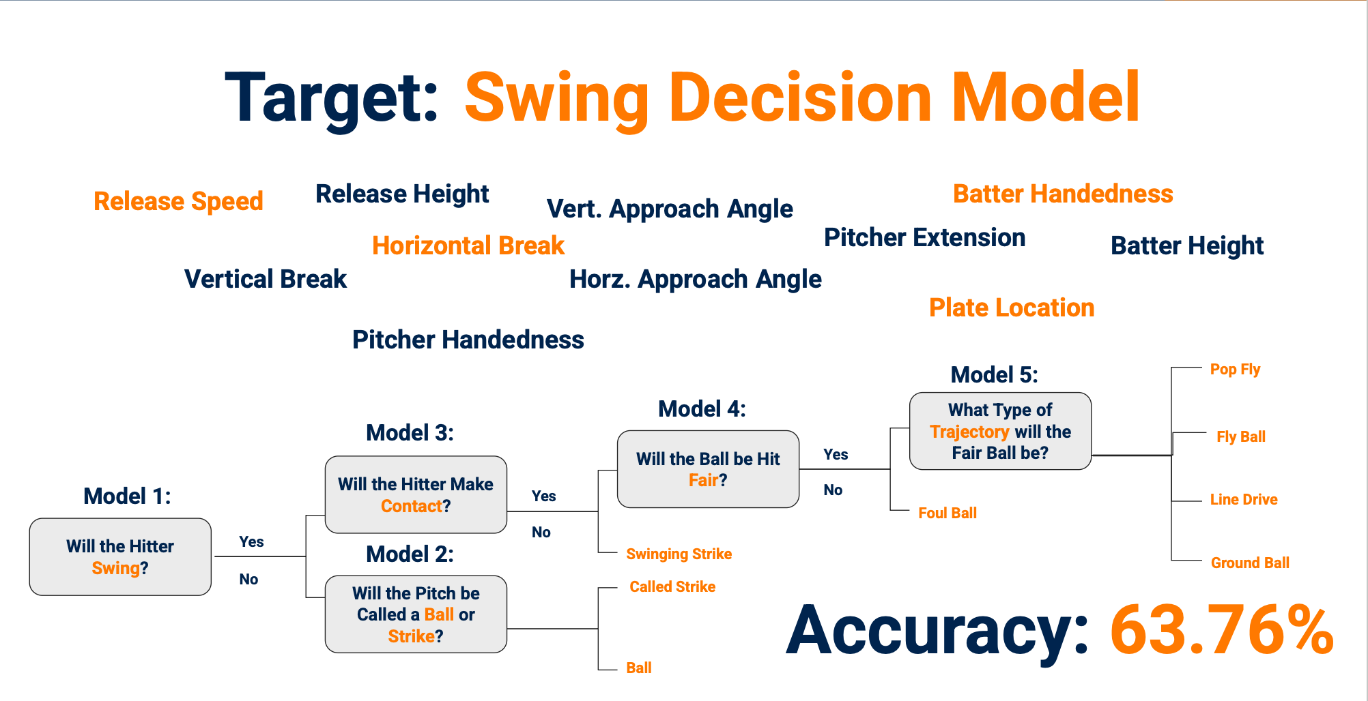
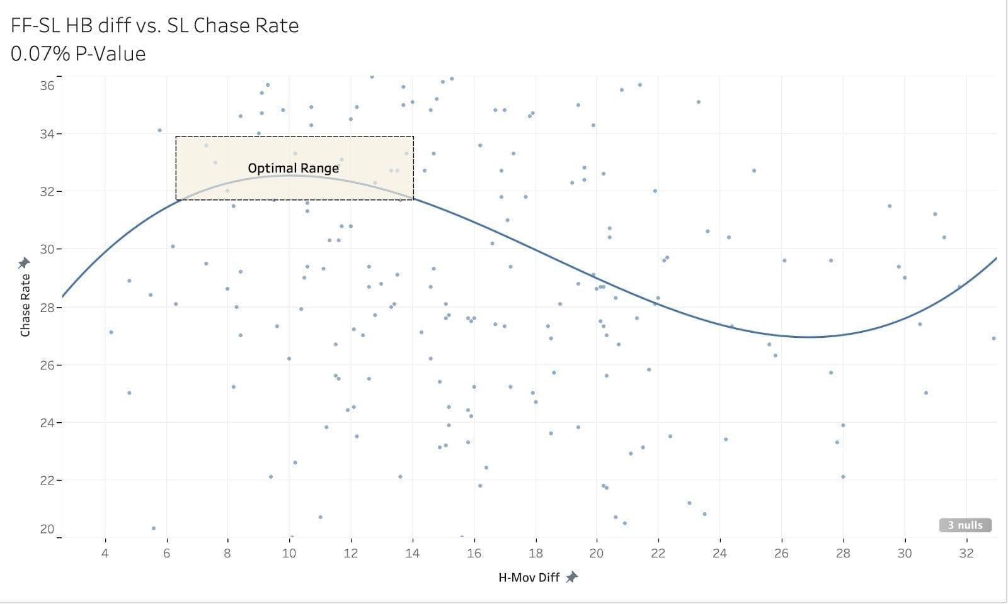
Modeling the Effects of Tunneling on Major League Baseball
Hitter Swing Decisions
Damon Cawthon, California State University, Fullerton
Dr. Kevin Nichols, Department of Natural Sciences and Mathematics, California State University, Fullerton
Background
Methods
Results (Continued)
“Tunneling” is the act of making two pitches look similar during their flight, before darting in separate directions with the intention of coaxing a hitter into swinging at a non-optimal pitch.
Gathering pitch characteristic data and trajectories to isolate pitch effectiveness to tunneling effects. Sourced from MLB Statcast.
Calculate pitch trajectories using 9-parameters given in data.
Compare pitch trajectories by creating a lattice between the two pitch trajectories, measuring 3d space distance between two points on each trajectory at or before the hitter’s reaction point at 200 timestamps per pitch. This results in a value called Path to Location Ratio
4) Model the value of a hitter’s swing decision on a per pitch basis. This is done using lightgbm modeling, taking 26 variables (pitch movement, pitch release point, pitch location, pitch spin characteristics,handedness), which are all independent of previous pitch. 7 individual models are run for binary classification on all possible outcomes from a pitch. These models are optimized using 30 rounds of Bayesian Optimization and run on the past 3 seasons of MLB pitch data. The model was able to predict the outcome of a pitch based on just the pitches characteristics 63.76% of the time, in addition to run value RMSE performing well. When comparing actual versus predicted swing decision run value, we get Swing Decision RV which isolates a hitter’s swing decision value to be independent of pitch effectiveness, isolating for tunneling.
5) Repurposed swing/no swing prediction model from swing decision cluster to create a Chase Above Expected metric, representing the predicted likelihood of a hitter chasing. Applied this to all pitches outside the strike zone.
6) Model x, y, and z weights in Path to Location Ratio calculation to maximize r² value with Swing Decision Run Value, attempting to compensate for a hitter’s inability to perceive depth of a pitch.
7) Observe results, compare Path to Location Ratio to different targets to understand where this calculation can be useful.
Figure 7
The graphs demonstrate the importance of nailing down the context in which a pitcher attempts to tunnel.
In all cases, the data looks generally random, though when understanding the context of the swing decision model, it becomes clear that this metric is in some way showing that good tunneling leads to good outcomes for pitchers.
In cases of extremely unexpected swing decisions (ex: model expects hitter to take a pitch, hitter swings at a pitch for a strike, model expects hitter to hit a line drive, hitter takes pitch for a strike), there is a clear trend towards good tunneling resulting in good tunneling resulting in good outcomes for a pitcher.
Figure 1. ^{[1]}
This image attempts to show the phenomenon, demonstrating what causes a hitter to make a poor “swing decision”. When 2 or more pitches look the same for a majority of each ball’s flight, it’s clear that this can make a hitter have trouble predicting where the ball is going to cross the plate.
Figure 4.
Graphic explaining the trajectory measurement showing difference between two pitches flights, compared to the difference in locations, resulting in the Path to Location Ratio.
Extremely unexpected
Swing Decisions
As tunneling gets better, swing decisions get worse
To this point, the most complete proof of how to quantify tunneling is constrained to only how a pitch moves in space due to spin (i.e. 7 inches of left horizontal movement, 15 inches of upward vertical movement).
Figure 2. ^{[2]}
This graph shows the vertical movement difference of a fastball and slider compared to chase percent, or the percentage of out-of-zone pitches that are swung at. The graph loosely trends towards showing there is an optimal range of movement difference that maximizes the chase percentage of a pitch compared to a fastball.
When successfully filtering to pitches where tunneling is most likely to be intentional, we are able to see that tunneling is often responsible for causing hitters to make extremely poor swing decisions.
.16 R² correlation between tunneling metric and Chases Above Expected for Sweepers and Sliders in the fourth quartile of Path to Location Ratio in putaway counts.
.12 R² correlation between tunneling metric and Chases Above Expected for ChangeUps and Splitters in 4th quartile of Path to Location Ratio in putaway counts.
Figure 5.
Graphic breaking down the method behind the swing decision model cluster.
Conclusion
This data analysis supports the following key takeaways:
Tunneling, as observed as the similarity between two pitch paths in comparison to when they cross home plate, is a significant factor in hitters making sub-optimal swing decisions at the major league level.
This relationship is most prevalent when comparing the relationships of non-fastball pitches playing off fastballs, in counts when it would be most optimal for a pitcher to tunnel a pitch out of the strike zone.
In cases of extremely good tunneling, the deception created between the difference in the two pitch types can be the main attribution causing a hitter to swing and miss.
The factors behind this phenomenon can be studied and understood, meaning we can use more basic pitch characteristics to improve a pitcher’s ability to tunnel.
Figure 3. ^{[2]}
Similar graph to Figure 2, but showing horizontal movement vs. chase percentage.
While figures 2 and 3 prove there are tangible benefits to two pitches that have movement profiles that may look similar to each other, this method does not include anything regarding location, release, or other factors. To fully understand and quantify tunneling as a factor in a pitcher’s performance, the proof needs to, in some way, include aspects of what the hitter is directly perceiving when deciding whether to swing or not.
Results
References
Figure 6.
While Swing Decision RV and Path to Location Ratio yield a 0.00037 R², their P-value of 2.2 x 10⁻¹⁶ shows there is some type of significance between the variables. Context is crucial to understanding their relationship. Tunneling is most purposeful when pitchers are ahead in the count, making out-of-zone non-fastball pitches more optimal. Correlation is between Swing Decision RV and P to L Ratio. Notice breaking pitches while ahead in the count are 10x as correlative as fastballs behind in the count.
1. J. Schwarz; Birds on the Black
2018; DOI: 10.birdsontheblack/pitch-tunneling-101
2. E. Rendon, E. Emery, W. Sugar, T. Alexander; Prospects Live 2022; DOI: 10.prospectslive/the-mystic-art-of-pitch-tunneling
Objectives
Acknowledgements
Can tunneling be proven as a real-time result of measured pitch trajectories?
Can we quantify tunneling as a measurable skill that pitchers can improve?
What factors go into tunneling to allow us to analyze what peripheral data can help a pitcher to improve their ability to tunnel?
Count | Fastballs | Offspeed (ChangeUp, Splitter) | Breaking (Slider, Curveball)
Behind (3-0, 2-0, 1-0, …) | .000247 R² | 0.0000437 R² | .000153 R²
Ahead (0-1, 0-2, 1-2, 2-2) | .000426 R² | .00332 R² | .00247 R²
Dr. Kevin Nichols
Titan Supercomputing Center Summer Research Program
Scott Jewett Fund for Innovation and Student Success.

